Slide 1

Overview Presentation

Slide 2
Banks serve Wall Street, Covesco serves all Streets!
There are currently no investment banking institutions which do not have any criteria regarding the material status of their clients. That is why we combined the ideas of crowdfunding and investment banking to create a way for ordinary people to gain access to investment banking like services. Covesco makes it possible for anyone to buy its newly emmited tokens and take advantage of our investment strategies.
Unlike any other financial services providers we do not collect any data about our customers and let them keep their privacy. Our clients allocate their funds with us by simply buying tokens during the ICO, which is probably the most convenient way of becoming a client of such an institution. Moreover, every client has the right to exit his position anytime by simply selling Covesco tokens.
Covesco offers higher returns than its competition, mainly because of our unique trading strategies and low commission costs. 80 percent of the annual profits are used to repurchase Covesco tokens. Remaining 20 percent account for Covesco profits, however 10 percent are kept as a safety fund to cover up possible losses in the upcoming years.

Slide 3


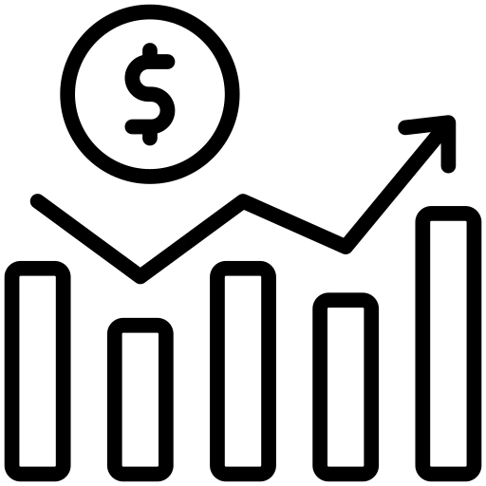

How does it work?
1. Investors buy tokens at the ICO and provide funds for Covesco’s investment practises.
2. Funds received from the sell of tokens are invested by our team. Portfolio of financial instruments bought is updated once a quater.
3. Profits are used to repurchase all the circulating tokens at a higher price (profits + initial funds from the sell of tokens/amount of tokens = repurchase price per token)

Slide 4
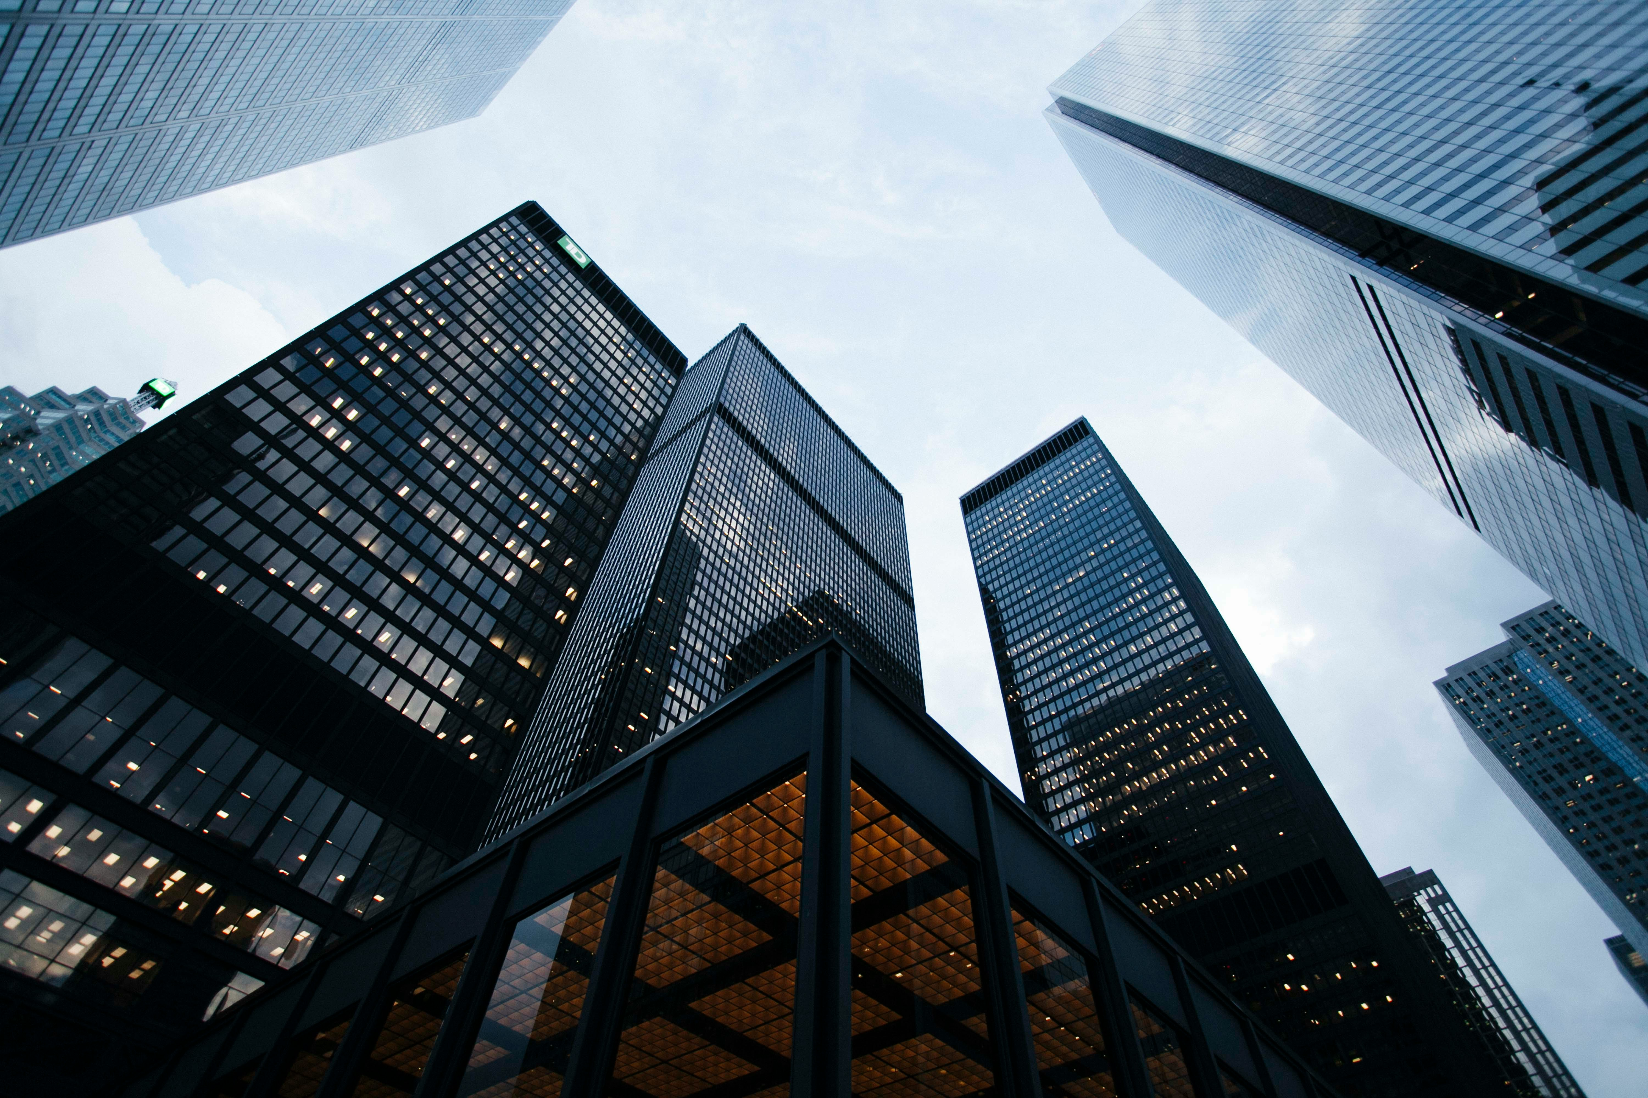
What do we invest in?
Information regarding our current positions will be released every quater and posted on our website and social media
We do not limit ourselves only to stocks and indices however these are the most common instruments we will be buying and selling
At the beginning of Covesco existence it is crucial for us to prove the effectiveness of our strategies, therefore we will not perform any types of agressive trading
In the historical profits tab it is possible to see how did our portfolio perform in the previous years

Slide 5

What happens to Covesco profits?
At the end of the year all of the existing positions are closed. We expect to make profits of about 40 % annually.
If a profit is made, 80 percent of it is destined to repurchase Covesco tokens from current holders. That is when the initial investors get their return from the investment.
The remaining 20 percent accounts for our personal income. Half of it is however stored as a safety fund in order to repurchase tokens in the following years if a loss is made.
For example: Covesco sells 1000 tokens for 10 $ per token and receives 10 000 $ in funds. The funds are invested and at the end of the year all the whole portfolio is liquidated. Covesco makes a profit of 50 percent and spends 14000 $ on repurchasing tokens. In that way amout of funds used to repurchase tokens is 40% larger than the initial market cap what leads to a surge in Covesco tokens price. With these gains Covesco tokens are repurchased at 14$ per token. At the same time 1000 $ is stored as a safety net for the following years. If the same amout of tokens at the same price are sold the next year the 1000$ are used to cover up the loss and buyback all of the tokens at the same price.

Slide 6
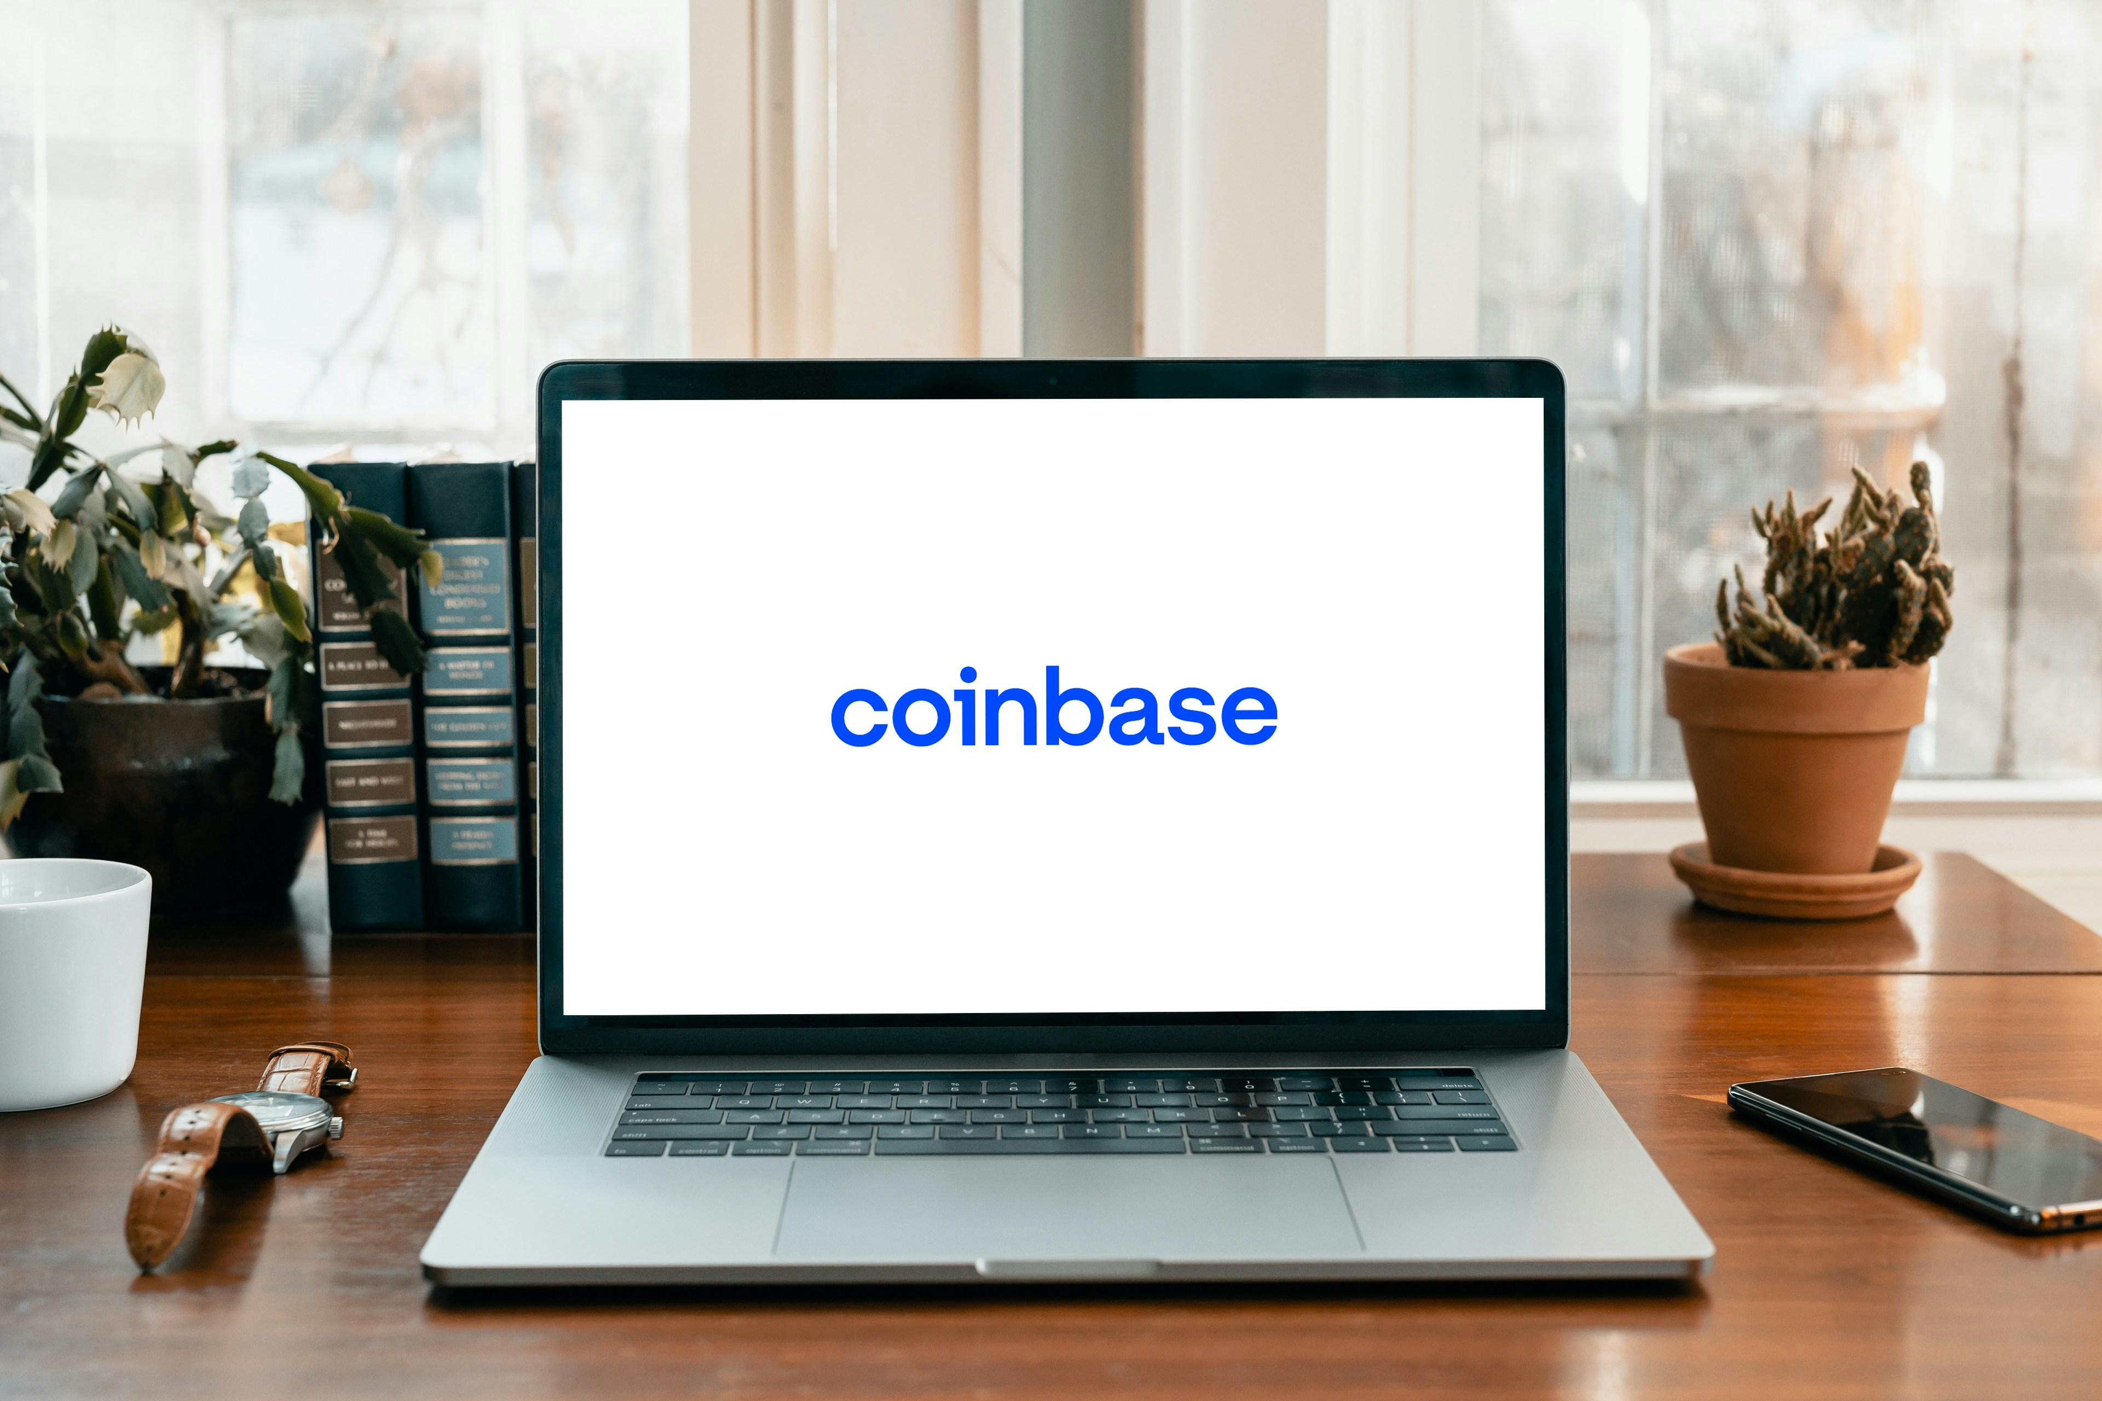
Goals at the beginning of Covesco development
Get listed at all major exchanges to simplify the exchange of Covesco tokens and gain more clients
Deliver profits to our clients systematically and outperform the competition
In the future start selling different types of tokens according to client’s risk acceptance
Promote Covesco to reach as many people as possible
Use 10 percent of profits to develop the safety fund
Make 40/50% profits anually

Slide 7
The end

